Slide 1
TDD & BDD Introduction
Mostafa Rastegar
Notes:
Tell the story about how I became associated with BDD because it is a good example of the efficacy of retrospectives. – BDD Questions – When do we do the BDD scenarios as acceptance criteria?

Slide 2





Current Software Development Life Cycle
Requirements might be misunderstood by each of the project team members
Based on this incorrect understanding, a faulty or buggy product is developed
It’s expected that the first step in every project is a discussion about the features, and behaviours of the software to be built
Many teams using Scrum and other agile methods suffer where to begin
Post-design test scenario may not cover the whole system features

Slide 3





Test Driven Development(TDD) lifecycle
Red
Refactor the code
Write a unit test
Validate that the test fails
TDD
Refactor
Green
Write just the minimum code necessary
Validate that the test passes successfully

Slide 4
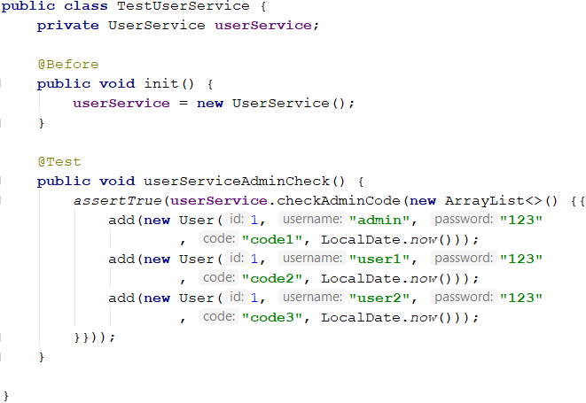
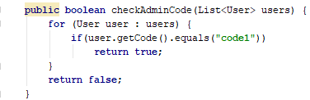
TDD Steps
Write some test case[s]
It definitely fails
Try to correct it
Pass test[s]
✓

Slide 5
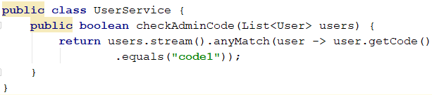
TDD Steps
Write some test case[s]
It definitely fails
Try to correct it
Pass test[s]
Code refactor
Outcome: The code coverage of
test case[s] will be 100%
✓

Slide 6
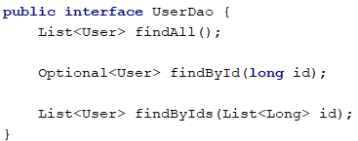
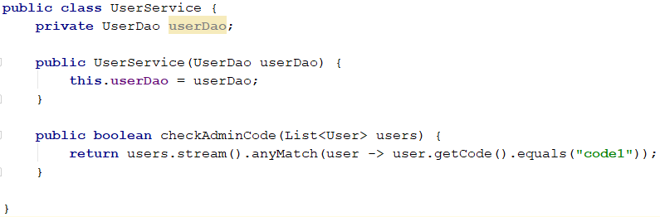
During writing unit tests, we sometimes need some mock objects or services to pass tests
Mockito is a powerful framework for mocking objects

Slide 7
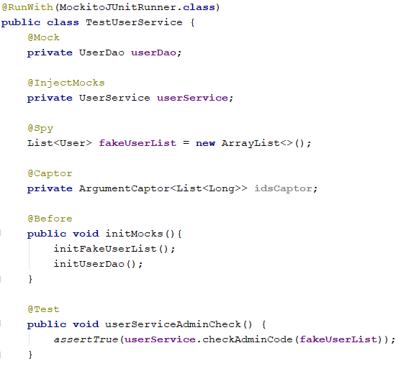
Mockito

Slide 8
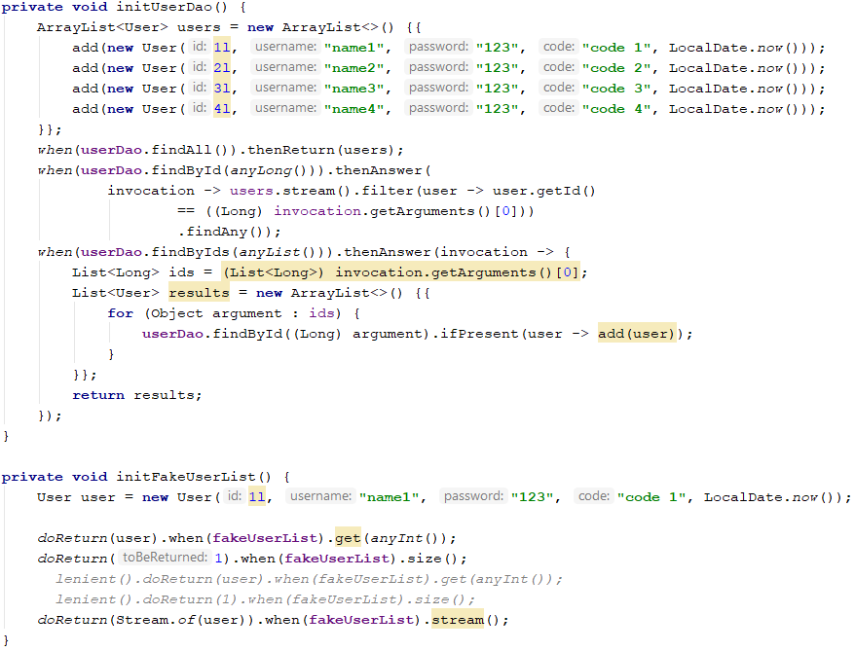
Mockito

Slide 9

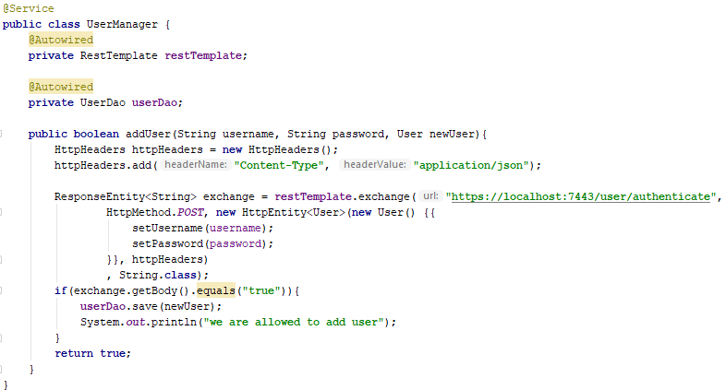
During writing unit tests, we sometimes need some mock objects or services to pass tests
Wiremock is also a library for stubbing and mocking web services.

Slide 10
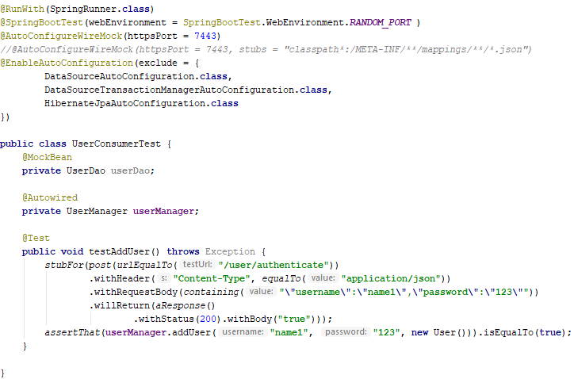
Wiremock

Slide 11
Behavior Driven Development(BDD) introduction
First, we should consider that BDD begins with Test Driven Development (TDD)

Slide 12
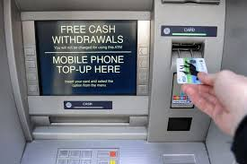
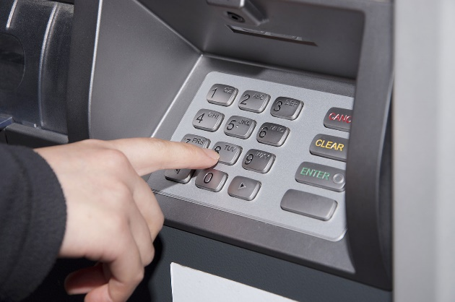
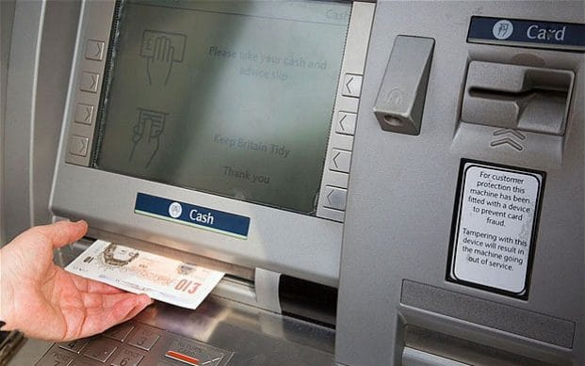
BDD
Let’s begin with an example called cash machine:
Given the account balance is £100
And the card is valid
And the machine has enough money
When the account holder requests £20
Then the cashpoint should dispense £20
And the account balance should be £80
And the card should be returned
The test scenario is in plain English

Slide 13
The test is made up three different sections
Context
Given the account balance is £100
And the card is valid
And the machine has enough money
When the account holder requests £20
Then the cashpoint should dispense £20
And the account balance should be £80
And the card should be returned
Event
Outcomes

Slide 14
The test is made up three different sections
Context
Starting State
What the user does
The expected results
Event
Outcomes

Slide 15
Behavioral tests can be written at any time
Before
Behavioral Driven Development
First focus on the behaviors that matter to the customer
During
After
Difficult to write unit case for an existing system
Writing behavioral tests for an existing system presents no special difficulties

Slide 16
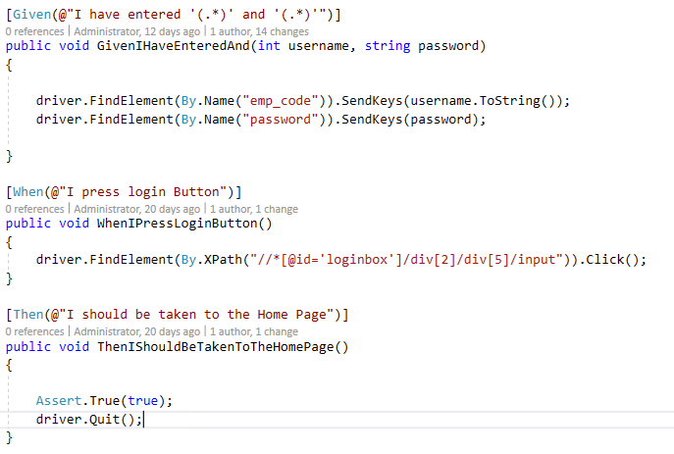
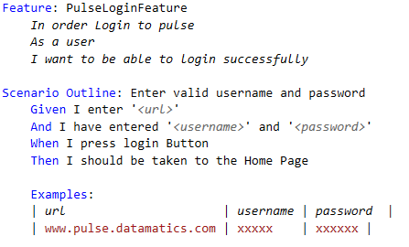
BDD Structure And Code Behind
BDD uses “Given/When/Then” structure to explain specification
• Given: Some initial Condition given by end client (e.g. Given the user has Application Url and enters the Username/ Password).
• When: Expected action occurs in application (e.g. When the user presses the Login Button).
• Then: Expected outcome of the action (e.g. Then I expect to see Application Home Page).
Automation QA translates each step into a method, which is used to implement its Given/When/Then step
The entire scenario is tested by running the corresponding methods step by step

Slide 17
When the developers begin their work
Behavioral Test
Behavioral Test
…
Behavioral Test

Slide 18
When the developers begin their work
Behavioral Test New Feature
Behavioral Test
…
Behavioral Test

Slide 19
When the developers begin their work
Behavioral Test New Feature
Behavioral Test New Feature
…
Behavioral Test

Slide 20
When the developers begin their work
Behavioral Test New Feature
Behavioral Test New Feature
…
Behavioral Test New Feature

Slide 21
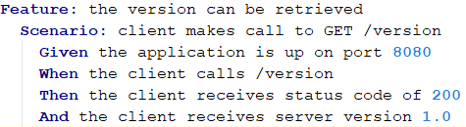
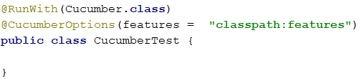
We use Cucumber for BDD
Feature file
Junit Class

Slide 22
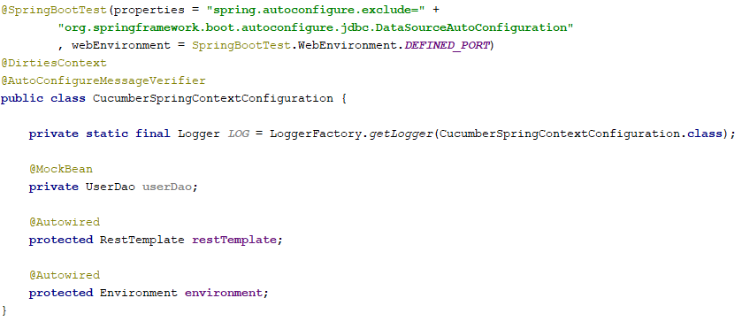
We use Cucumber for BDD
Integration Class With Spring Framework

Slide 23
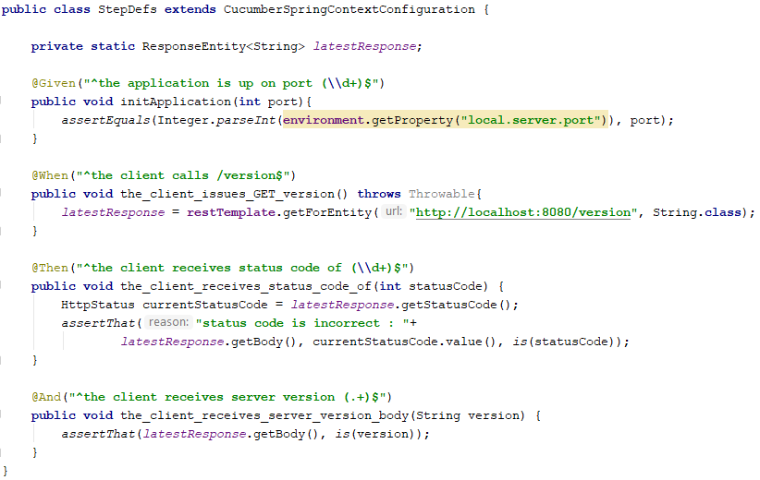
We use Cucumber for BDD
Corresponding Steps Class

Slide 24
BDD Team Roles
Business Users
Test Automation QA’s are responsible for implementing each scenario using the BDD framework, according to the user stories that were created by the business users
Test Automation QA’s
Business Users are domain experts and understands application flows from a user’s point of view. This role can be shared with product owner and business analyst
Developer
Developer translates user story scenario into a function which is used to implement the steps into given in acceptance criteria

Slide 25
BDD Advantages
Strong Team Communication
Better Team Understanding
Better Requirement Understanding
Better Build Quality
Ensures Automation at early stage of development
New release of our software should pass the whole designed scenarios

Slide 26
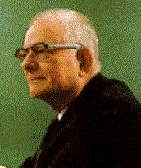
W. Edwards Deming¹
“Quality comes not from inspection, but from improvement of the production process. “
“We cannot rely on mass inspection to improve quality… As Harold S. Dodge said many years ago, 'You cannot inspect quality into a product.' The quality is there or it isn't by the time it's inspected. “

Slide 27

Questions

